Slide 1
HOUSEHOLD ANALYSIS DASHBOARD
Group members-
Shubham Patil
Akshat Shukla
Aishwarya Naidu
Raina Kishor
Jayneeta Sinha
Priyanka Koparkar

Slide 2
Purpose
To analyse various household parameters.
To analyse the variation of parameters against each other.
To compare the statistics of data in different years.

Slide 3
Flow of Work
The parameters for analysis were decided as
Population
Gross Domestic Product (GDP)
Per Capita Income (PCI)
Gross Enrolment Ratio
Literacy
Household (HH)
Source of Data : www.data.gov.in
Data on above parameters was collected and filtered according to our requirement.

Slide 4
Schema for database was decided
Data collected was stored in database
Front end (UI) designed was decided (mock)
Handler classes , Service classes , Data classes , DAO classes were made for each table in database.
A attractive dashboard was designed to show the various visualizations.

Slide 5
Technologies Used
1. MySQL:
MySQL is the most popular Open Source Relational SQL database management system. MySQL is one of the best RDBMS being used for developing web-based software applications.
MySQL was used as database to store data in our project.

Slide 6
Database Schema

Slide 7
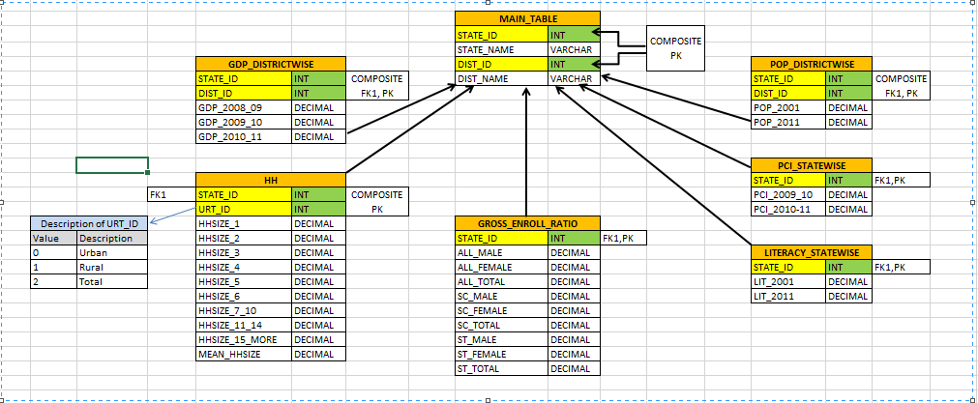

Slide 8
2. Angular JS
Angular JS is a very powerful JavaScript Framework used in Single Page Application (SPA) projects.
Angular JS was used for driving purpose in the project
3. Angular Material
Angular material provides a set of reusable, well-tested, and accessible UI components based on Material Design.
The dashboard coding is done using angular material.
4. Angular Dimple
Angular dimple is a framework based on d3 and dimple Js.
It is used to create visualizations.
The charts and graph were created using angular dimple.

Slide 9
5. CSS
CSS is used to control the style of a web document in a simple and easy way.
CSS is used to style the web page .
6.Java web services
Web service is a technology to communicate one programming language with another.
For example, java programming language can interact with PHP and .net by using web services.
In other words, web service provides a way to achieve interoperability.

Slide 10
Service Layer / Application Logic

Slide 11
Application Architecture
UI
Services
Handler
DAO
Data Objects
Database

Slide 12
Services
Makes use of Path annotation provided by JAX-RS api to export classes as REST Services on the Server
Methods marked with Get annotations respond to GET requests to the Path
The QueryParam annotation is used to get Query parameters from the inbound request and inject them into function arguments
Based upon the request, required Handler is invoked.

Slide 13
Handlers
Calls respective DAO classes
Converts the returned ArrayList and serializes it to a JSON with the help of Google GSON

Slide 14
DAO – Data Access Objects
Handles the DB interaction Logic
Consumes the Result Set and puts it into an ArrayList
Returns the resulting ArrayList to the Handler

Slide 15
Data Objects
Resembles the underlying database schema closely

Slide 16
Query Builder
Query Builder Java Code incorporates within it basic clauses of SQL such as SELECT, FROM, WHERE and GROUP BY.
The Builder code consisted of parameters such as List of Strings(for columns), Map of (Strings, Strings) (for tables), List of Strings for WHERE statements and String for GROUP BY.

Slide 17
Challenges Faced:
Collecting the district data for each state.
Rendering the data on the Map.
Rendering multiple parameters on same graph.
Resizing problems with DimpleJS
Label Overlap issue with DimpleJS

Slide 18
Improvements:
The 4 panels could be merged into 1.
Data sink in graphs of state.
Making the maps more resizable.

Slide 19
THANK YOU

